Slide 1
Computer and Network Orientation
Kathy Myers, Director of IT
Evan Lavelle, Bioinformatics Analyst
Ethan Price, Project Assistant
Brought to you by:

Slide 2
Ethan Price – NCGR Project Assistant
Born & raised in Albuquerque, NM
Back to School!
Engineering / C.S.
Grocery Industry for 15 years

Slide 4
Overview
DON’T PANIC!
Computer terms ahead
Sounds like a foreign language
By the end of the week, you will understand

Slide 5
What we should accomplish
Ensure everyone:
Has a working personal computer and access to the resources provided
Has required and suggested software
Understands “shell” and “operating system”
Terminal access (MobaX for Windows. Mac users have a built in terminal.)
Can login to the Linux analysis server logrus housed at NCGR

Slide 6
Why are we doing this?
Scientific computers are SUPER FAST and needed for big data
CPU(s): 88
MemTotal: 528074992 kB
They also only do what they are told
They are accessed using a terminal interface

Slide 7
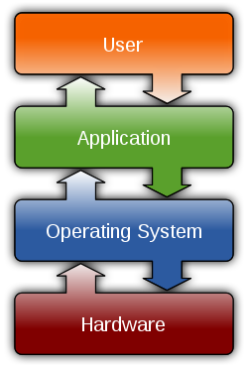
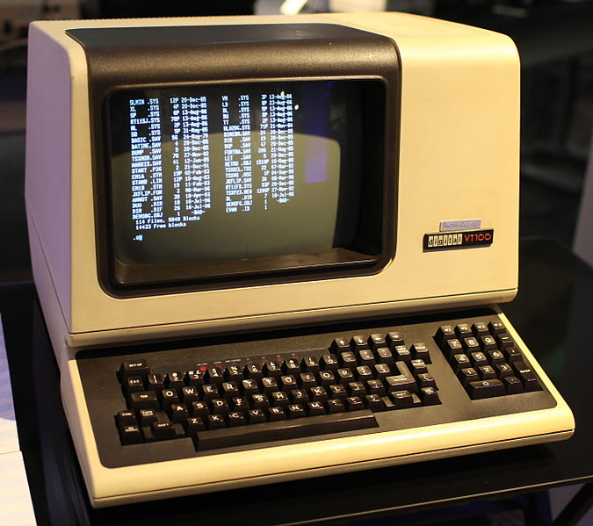
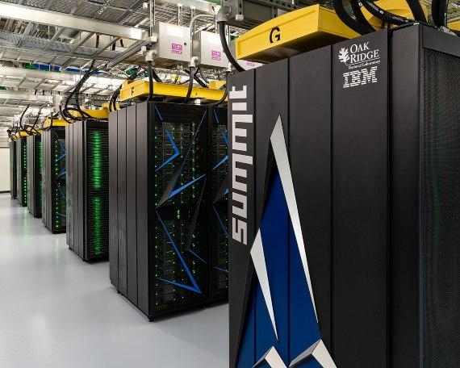
What’s a shell? What’s an operating system (O/S)?
terminal
You are the Master!
Command Line Interface (CLI)
bash (Bourne Again Shell)
O/S Common features
Process management Interrupts Memory management File System Networking Security
Manages computer hardware, software resources, and provides common services to software programs
Linux O/S
logrus analysis server
Hardware: Central processing unit (CPU) disk, RAM, graphic card, sound card, motherboard, etc.

Slide 8
What is logrus?
logrus is the name of an NCGR compute analysis server that uses Linux as an operating system
Running bioinformatics programs on a desktop machine is oftentimes infeasible (not enough CPUs, disk, RAM)
Logging into logrus through a “terminal” enables us to leverage its vast compute power for large datasets

Slide 9
Terminal (needed to connect to the analysis server logrus from your laptop)
Windows: MobaX
Macintosh: built-in terminal
Linux: Xterm & others are built in
Notes:
(trouble?)

Slide 10
Windows users: Connect using MobaX terminal
Click on “New session”
Remote host 🡪 gateway.training.ncgr.org
Select “Specify username” checkbox
Enter your username
Port 🡪 44111
Click on “OK”
Do not save your password
You should now see a terminal connection

Slide 11
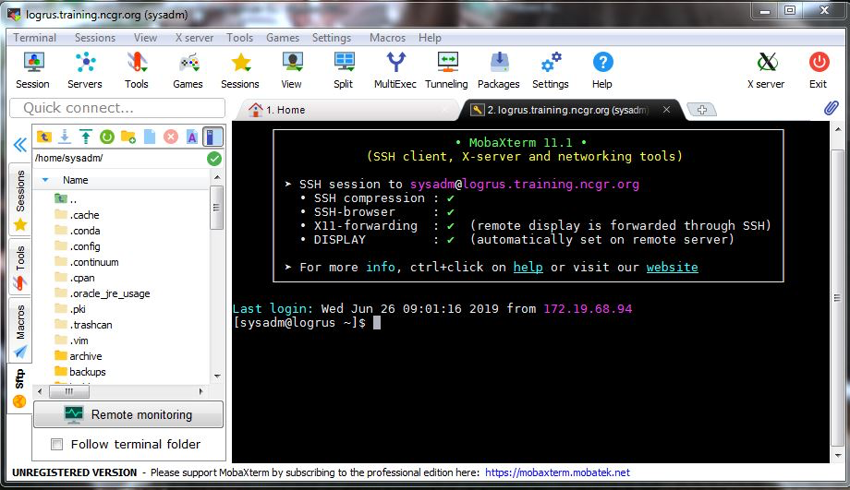
MobaX Terminal

Slide 12
Pasting into MobaX
A user cannot paste into the MobaX terminal by use of CTRL + v
Right clicking and selecting “paste” will open a dialogue box to confirm the text to be pasted
If you want to paste upon simply right-clicking, select the terminal tab in settings 🡪 configuration, then check ”paste using right-click” in the terminal features box

Slide 13
Logging into logrus remotely (e.g. from home)
Indicate port number 44111 which firewall allows
Windows (using MobaX)
Host Name = gateway.training.ncgr.org
Port = 44111
Mac
$ ssh –p 44111 <username>@gateway.training.ncgr.org

Slide 14
Signing in to logrus
Login: First letter of first name & up to seven letters of last name
password: provided over the phone or by google drive by Ethan
Ex: John Jayden is jjayden
Ex: Ashley Smitherson is asmither
Mac and Linux users use SSH (Secure Shell) to login to logrus
$ ssh -p 44111 <username>@gateway.training.ncgr.org
Will then ask you for your Password:
Result:
[<username>@logrus ~]$

Slide 15
Change your password!
While logged into logrus
Pick a strong password
Ten characters or more
Mixed Case, digits, punctuation
Change your password
<you> $ passwd

Slide 16
Q / A

